Slide 1

Robotics Camp-2022
Session: 01, Class: 1st

Slide 2
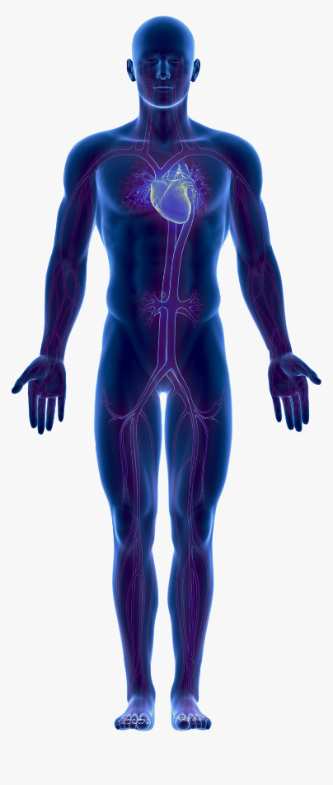

Robotics Camp-2022
Sensor & Load
vs

Slide 3
Robotics Camp-2022
Sensor & Load
Fundamental theme of Automatic System
Input
Process
Output
Sensors
Loads
Microcontroller
Processors

Slide 4
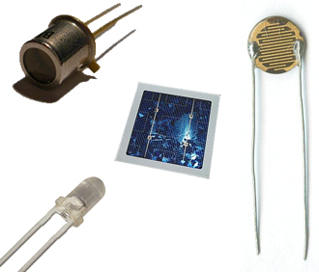
Robotics Camp-2022
Sensor & Load
Name of Sensor
Photo
Detected Substance
Output Signal

Slide 5
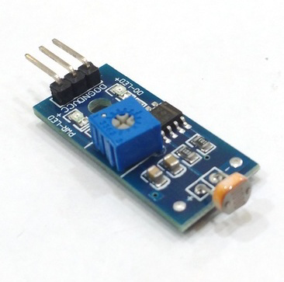
Robotics Camp-2022
Sensor & Load
Light Sensor
Light Intensity
High/1

Slide 6
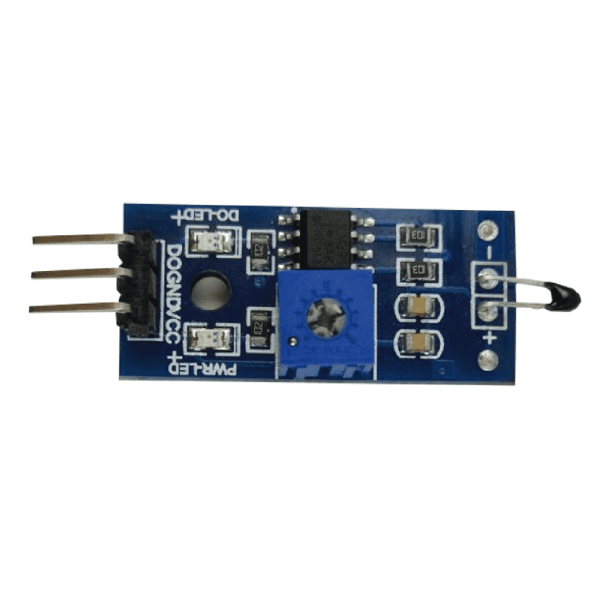
Robotics Camp-2022
Sensor & Load
Temperature Sensor
Temperature
High/1

Slide 7
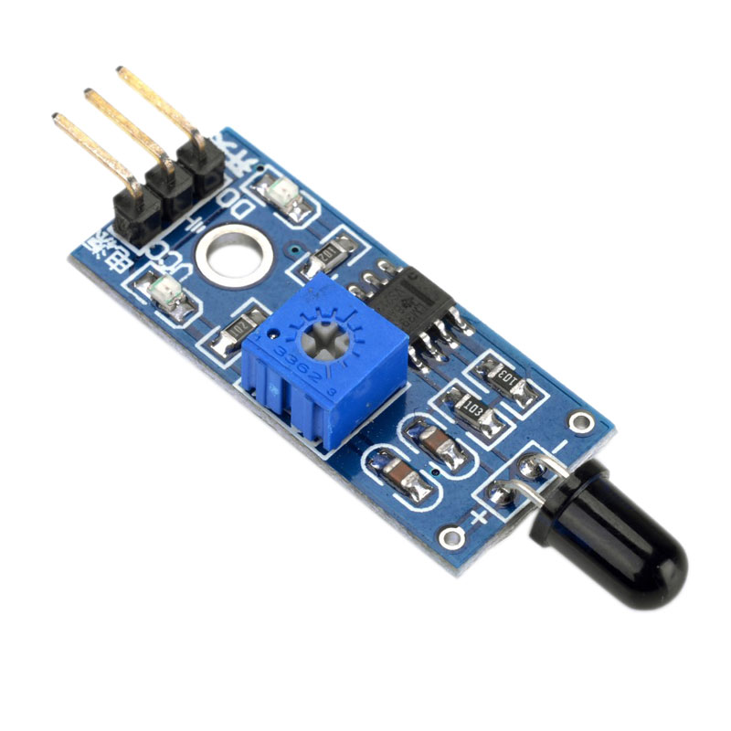
Robotics Camp-2022
Sensor & Load
Fire Sensor
Flame
High/1

Slide 8
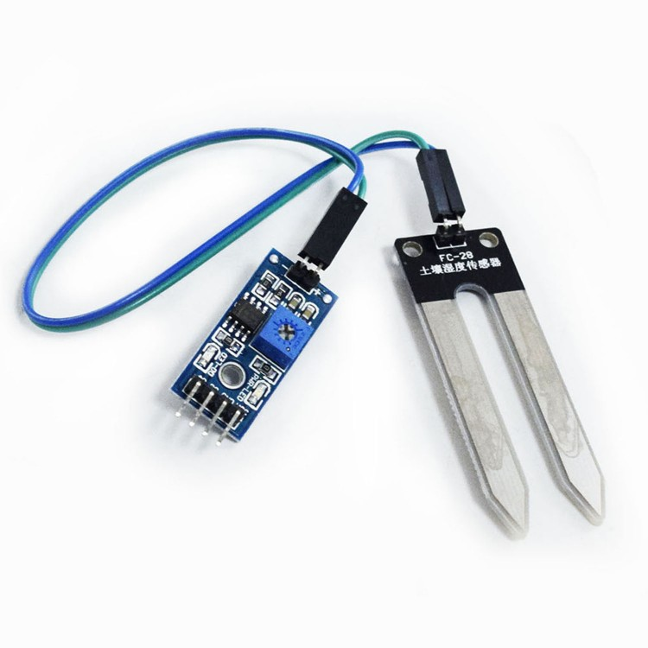
Robotics Camp-2022
Sensor & Load
Water Sensor
Water
High/1

Slide 9
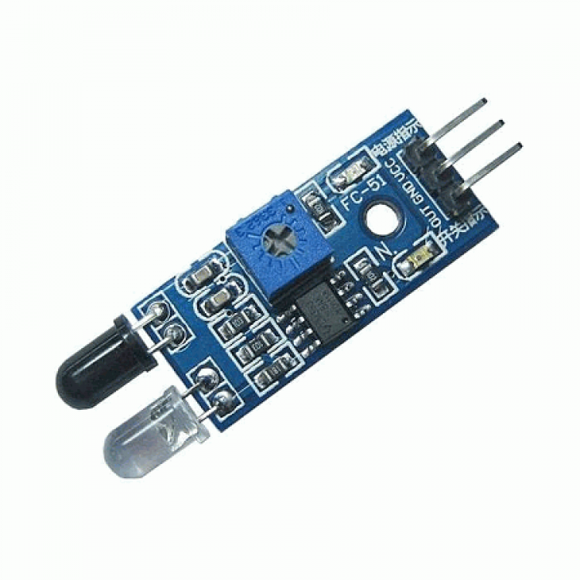
Robotics Camp-2022
Sensor & Load
Obstacle Sensor
Object/Obstacle
High/1

Slide 10
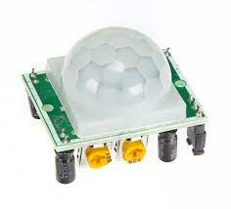
Robotics Camp-2022
Sensor & Load
Motion Sensor
Human/Red Blood Animal
High/1

Slide 11
Robotics Camp-2022
Sensor & Load
Loads
LED Lamp
Buzzer
DC Motor
Water Pump
Geared Motor

Slide 12
Robotics Camp-2022
Sensor & Load
Assignment
5 Sensors Name and Details
5 Loads Name and Details
Use Bangla
Post to Roboment Community group
Within 7:00pm Jan 17, 2022

Slide 13
THANK YOU

